Slide 1



DATA STRUCTURES AND ITS APPLICATIONS
Balanced Trees
Sandesh B. J
Department of Computer Science & Engineering

Slide 2


DATA STRUCTURES AND ITS APPLICATIONS
Balanced Trees
Sandesh B. J
Department of Computer Science & Engineering

Slide 3

DATA STRUCTURES AND ITS APPLICATIONS
Balanced Trees
In this lecture you will be able to learn:
Why trees becomes unbalanced?
Why we need to balance the tree?
AVL Tree
How do we balance the unbalanced trees using
tree rotation techniques
Different tree Rotation techniques
  Left rotation, right rotation
  Left-right rotation and right-left rotations

Slide 4

DATA STRUCTURES AND ITS APPLICATIONS
Balanced Trees
Why Balanced Trees?
Binary Search Tree(BST) – Data Structure used to implement the dictionary.
What do we gain by implementing dictionary using BST instead of array ?
Complexity of Binary Search Tree
Operations | Average | Worst
Insert | O(log(n)) | O(n)
Delete | O(log(n)) | O(n)
Search | O(log(n)) | O(n)

Slide 5
DATA STRUCTURES AND ITS APPLICATIONS
Balanced Trees
Why Balanced trees?
8
Height of the BST depends on the order of
insertion of elements into tree
What happens if we insert elements given in
increasing order?
  Insert 8, 12, 20, 25, 27, 30, 35, 40
Severely unbalanced
12
20
25
27
30
35
40

Slide 6

DATA STRUCTURES AND ITS APPLICATIONS
Balanced Trees
Disadvantages of Binary search trees
The search and insertion algorithm does not ensure that
the tree remains balanced
The degree of balance dependent on the order in which the keys are inserted
Tree can attain a height which can be as large as n-1
Time taken for most of the operations worst case O(n)

Slide 7
DATA STRUCTURES AND ITS APPLICATIONS
Balanced Trees
Why Balanced trees?
30
25
35
12
27
40
8
20
we can construct the binary search tree in which the height of the tree is always log(n)
Complexity of Balanced Binary Search Tree
Operations | Average | Worst
Insert | O(log(n)) | O(log(n))
Delete | O(log(n)) | O(log(n))
Search | O(log(n)) | O(log()n)

Slide 8

DATA STRUCTURES AND ITS APPLICATIONS
AVL Tree-Balanced Binary Search Trees
AVL tree was invented in 1962 by two Russian mathematicians G.M. Adel’son-Vel’skii and E.M. Landis(AVL)
An AVL tree is a binary search tree in which, for every node, the difference between the heights of the left and right subtrees, called the balance factor is either 0 or +1 or -1
The Balance factor of any node:
Balance Factor = Height(left subtree) – Height(right subtree)

Slide 9
DATA STRUCTURES AND ITS APPLICATIONS
Balanced Binary Search Trees(AVL)
HL=3
30
HR=2
25
35
Balance Factor = HL - HR
12
27
40
8
20
HL=1
12
HR=1
Balance Factor at node(30) = 3 – 2 = 1
8
20
Balance Factor at node(12) = 1– 1 = 0
HL=2
25
HR=1
HL=0
12
27
35
HR=1
8
40
20
Balance Factor at node(25) = 2 – 1 = 1
Balance Factor at node(35) = 0 – 1 = -1

Slide 10
DATA STRUCTURES AND ITS APPLICATIONS
Balanced Binary Search Trees(AVL)
1
1
30
30
0
2
-1
-1
25
35
25
35
1
1
0
0
0
12
27
40
12
40
0
0
0
0
8
20
8
20
AVL Tree
Not an AVL tree
Node in balanced binary tree has balance of
1 – Height( left subtree) > Height(right subtree)
0 – Height( left subtree) = Height(right subtree)
-1 – Height( left subtree) < Height(right subtree)

Slide 11
DATA STRUCTURES AND ITS APPLICATIONS
Rotations – AVL Tree
The AVL tree may become unbalanced after insert and delete
operations
If a key insertion violates the balance requirement at some
node, the subtree rooted at that node is transformed via one
of the four rotations.
Rotation in a AVL tree is a local transformation of its subtree
rooted at a node whose balance has become either +2 or -2
In case there are several such nodes, The rotation is always
performed for a subtree rooted at “unbalanced" node closest
to the newly inserted leaf node.

Slide 12
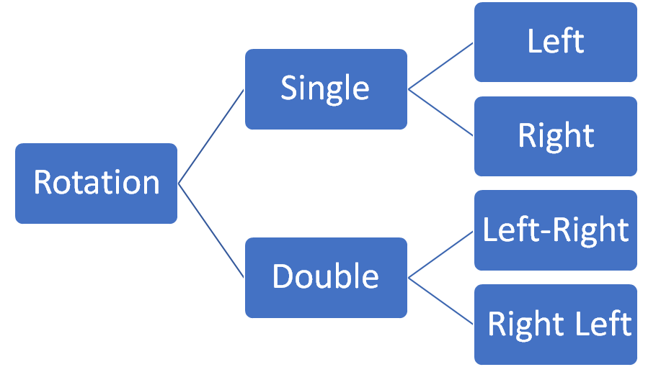
DATA STRUCTURES AND ITS APPLICATIONS
Rotations – AVL Tree
Different types of Rotation:

Slide 13
DATA STRUCTURES AND ITS APPLICATIONS
Rotations - AVL Trees
Single Right Rotation (R-Rotation)
1
0
2
8
R
6
1
0
0
0
6
4
8
0
4
Root of the tree has balance of +1 before the insertion
New key is inserted to the left of left child (Left-Left-case)
To Balance the tree we need to perform the right rotation
Courtesy: “Introduction to Design and Analysis of Algorithms” By Anany Levitin

Slide 14
DATA STRUCTURES AND ITS APPLICATIONS
Rotations - AVL Trees
Single Left Rotation:
-1
0
-2
3
L
0
5
0
-1
0
5
0
3
7
7
Root of the tree had balance of -1 before the insertion
New key is inserted to the right of right child (Right-Right-case)
To Balance the tree we need to perform Left Rotation
Courtesy: “Introduction to Design and Analysis of Algorithms” By Anany Levitin

Slide 15
DATA STRUCTURES AND ITS APPLICATIONS
Rotations - AVL Trees
Double Left Right Rotation:
1
2
r
2
r
0
8
8
R
0
L
1
6
-1
0
0
4
6
0
0
4
8
6
4
Root r had the balance of +1 before the insertion
New key is inserted to the right of left child (Left-Right-case)
We perform the left rotation of left subtree of root r
Right rotation of the new tree rooted at r
Courtesy: “Introduction to Design and Analysis of Algorithms” By Anany Levitin

Slide 16
DATA STRUCTURES AND ITS APPLICATIONS
Rotations - AVL Trees
Double Right Left Rotation:
1
-2
-2
r
r
0
3
L
1
R
3
5
0
-1
0
0
7
5
3
7
0
0
5
7
Root r had the balance of -1 before the insertion
New key is inserted to the left of right child (Right-Left-case)
We perform the right rotation of right subtree of root r
Left rotation of the new tree rooted at r
Courtesy: “Introduction to Design and Analysis of Algorithms” By Anany Levitin

Slide 17
DATA STRUCTURES AND ITS APPLICATIONS
Example – Rotations in AVL Trees
1
2
60
1
0
2
50
70
0
0
0
1
0
55
80
30
65
1
0
0
1
25
35
60
0
0
0
10
70
30
0
0
0
1
65
80
50
25
0
0
0
35
55
10
Courtesy: “Introduction to Design and Analysis of Algorithms” By Anany Levitin

Slide 18
DATA STRUCTURES AND ITS APPLICATIONS
General form of Right-Rotation
Y
X
X
Y
T3
T1
T2
T1
T2
T2
T3
T3
keys( T1) < X < keys( T2) < Y < keys(T3)
Courtesy: “Introduction to Design and Analysis of Algorithms” By Anany Levitin

Slide 19
DATA STRUCTURES AND ITS APPLICATIONS
General form of Left – Right Rotation
Z
X
Y
T4
keys( T1) < X <keys( T2) < Y < keys(T3) < Z < keys(T4)
T4
T1
T2
T3
OR
Y
X
Z
Z
T2
Y
T2
T2
T3
T4
X
T4
T4
T1
T4
T3
T2
T1
Courtesy: “Introduction to Design and Analysis of Algorithms” By Anany Levitin

Slide 20

THANK YOU
Sandesh B. J
Department of Computer Science & Engineering
sandesh_bj@pes.edu
+91 80 6618 6623

